Slide 1
Automated in-situ sensors & spatiotemporal modelling to monitor Harmful Algal Blooms(HABs) - Case Study-Lake Victoria
Presenter:
Name: OKELLO, JACOB OKOMO
Reg. No: ENC222-0149/2017

Slide 2
Introduction
Toxic Cyanobacteria-rich Harmful Algal Blooms (CyanoHABs) , a phenomenon in which the water body e.g. lakes turns dark blue-green due to excessive algal growth; potentially harming humans and animal, e.g., Unsightly nuisance, acute liver damage when ingested, irritation, fish deaths, etc.
- WHO
Hence, quantifying the detailed spatial distributions of CyanoHABs in L. Victoria on a regular and frequent basis is of great significance, which requires high spatiotemporal resolution monitoring abilities- (Sitoki et al., 2012)
There however exists that niche to support the near-real time space observations with a geointelligent reporting system and further predict any looming bloom.

Slide 3
Problem statement
The rapidly escalating demographics along L. Victoria riparian reserves has negatively impacted water quality through deposits of agricultural, industrial runoff and sewer refuse eutrophicating the said region. (Burkholder et al., 2006; MOH)
Deterioration in water quality initiates ecosystem conflicts, furthermore baring achievement of SDG 6 & 14- Clean Water and Sanitation.
Coupling wide spread spatiotemporal monitoring, and Automated in-situ sensors will play a big deal in return. This would inform the Govt. and the general public the affected zones. Further prediction would add more taste to this solution.

Slide 4
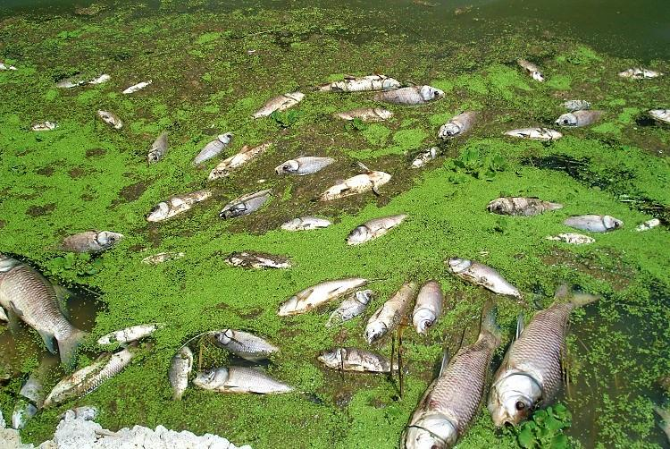
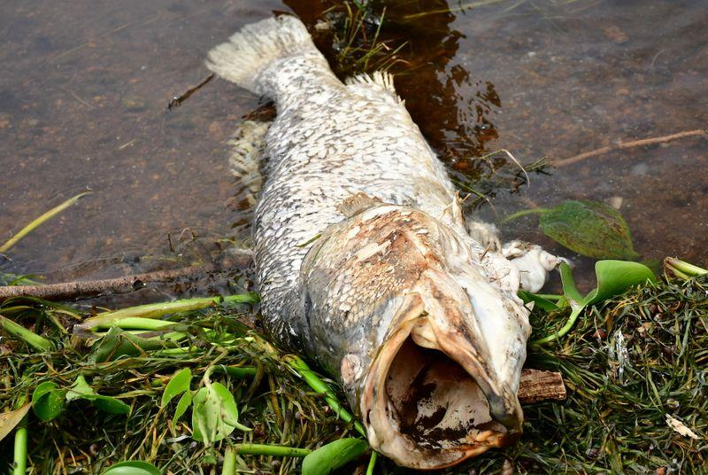
Justification

Slide 5
General and specific objectives
To monitor and report the occurrence of Harmful Algal Blooms(HABs) and Cyanobacteria in Lake Victoria.
To monitor chlorophyl-a(chl-a) concentration & Cyanotoxins from L8 OLI images.
To monitor Lake Surface Water Temperature(LSWT) from L8 TIRS images as another HAB indicator in L. Victoria.
To develop automated Internet of Things (IoT) in situ sensors, Applicable in near real-time to monitor and report geo-tagged Water quality data.

Slide 6
Overall Methodology : Data and Materials
Data Type | Source | Role/Use
Landsat 8 OLI | Google Earth Engine (2015-2020) | Spatiotemporal HAB Monitoring
Landsat 8 TIR | Google Earth Engine (2015-2020) | Lake Surface Temperature Monitoring
Meteorological Data | Kenya Marine & Fisheries Research Institute-KMFRI (2015-2020) | Water Quality assessment
Shapefiles | Geodatabase of Global Administrative areas- GADM | Delineate the Study area
In-Situ Data | In-situ Sensors 2021 Onwards | Continued In-Situ Algal Monitoring
Tool/Material | Role | Availability
Google Earth Engine | Geocomputation & Processing | Freely Available
QGIS, R & Python | Further Analysis & Maps | Free
Microcontroller & Sensors | In-Situ data Monitoring | Local Purchase
KiCAD | Design the Schematics & basic Circuits | Free & Open source

Slide 7
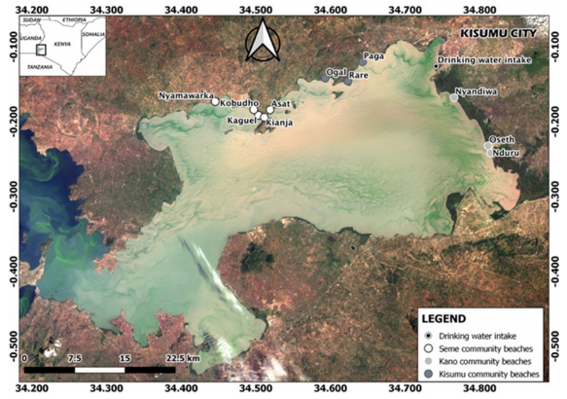
Study Area

Slide 8
Atmospheric Corrections
TIRS Data
Landsat 8 images
Geometric Corrections
OLI Data
TIRS B10
B5 NIR
B4 RED
B2 GREEN
B2 BLUE
NDVI
TOA DN to At-Sensor Radiance(Lλ)
Basic Chl-a algorithm(log₁₀)
Proportional of Vegetation(Pv)
At-Sensor Spectral Radiance to Brightness Temp (Tb₁₀)
Lake Surface Emissivity (LSE)ε
Estimate Lake Surface Water Temp (LSWT)
Below Threshold
Above Threshold
CDOM
Spatiotemporal Monitoring

Slide 9
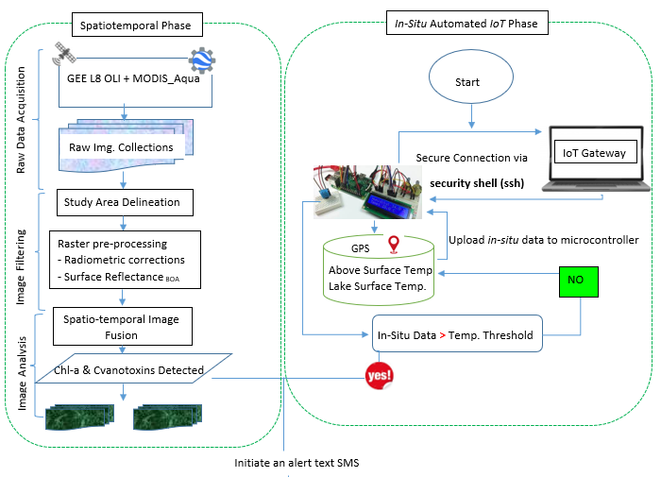
Overall methodology

Slide 10
Expected Results
Chlorophyl-a Geographical Maps associating the occurrence of the Harmful Algal Blooms and Cyanobacteria.
Autonomous system that monitors and reports geo-tagged data
Reported confirmation alert Text SMS reporting in near-real time the in-situ status from the sensors.

Slide 11
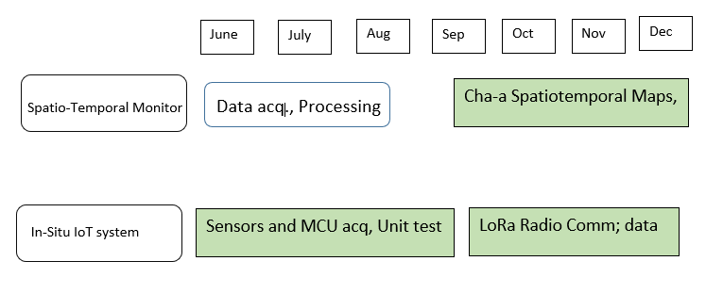
Project Timeline

Slide 12

Thank you for your attention! Questions?

